Slide 1
11 & 12기 정규세션 7주차
ToBig’s 11기 이소라
Training Neural Networks
11 기 이소라

Slide 2
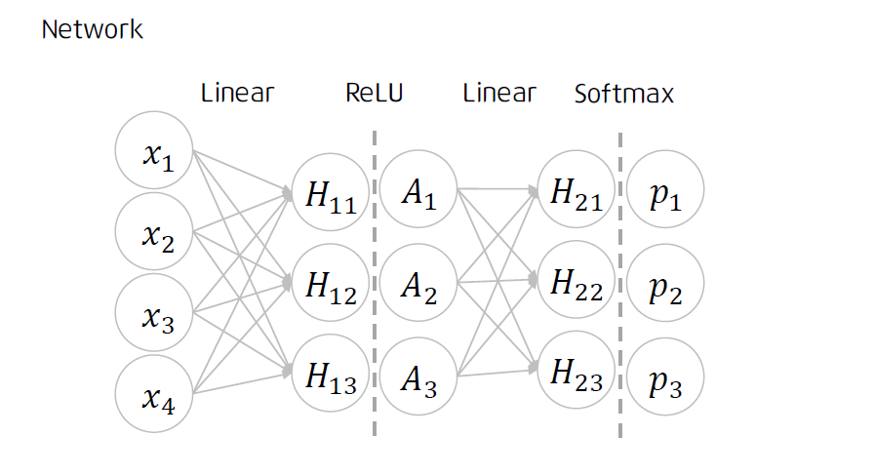
Unit 01 ㅣ Review
Forward
Loss
Backpropagation
Update parameters

Slide 3
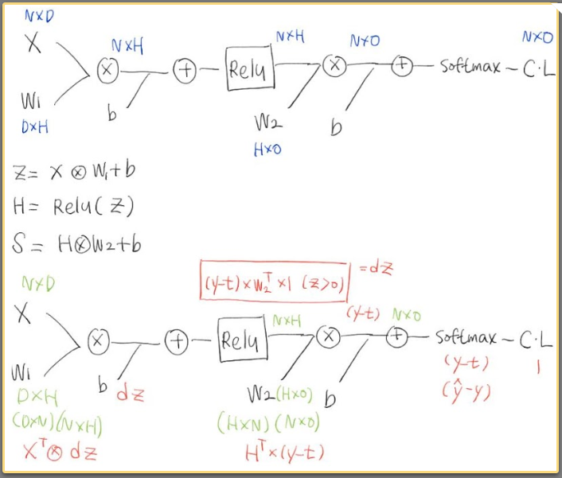
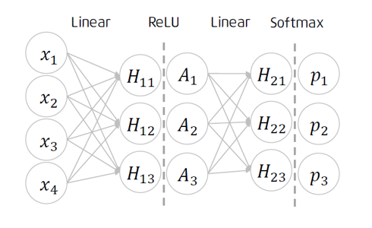
Unit 01 ㅣ Review

Slide 4
Unit 01 ㅣ Review
Neural Networks
Forward
Loss
Backpropagation
Update parameters
원리는 알았고 이제 학습시켜보자

Slide 5
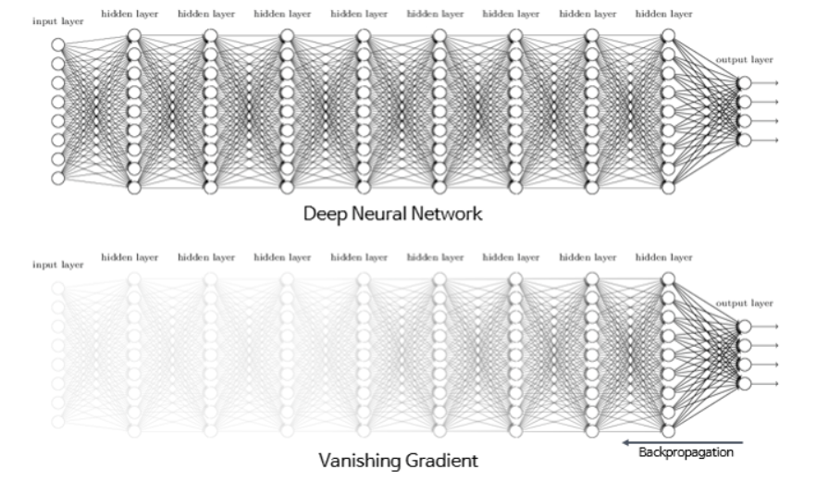
Unit 01 ㅣ Review

Slide 6
Unit 01 ㅣ Review
Unit 02 ㅣ Activation Function
Contents
Unit 03 ㅣ Weight Initialization
Unit 04 ㅣ Optimization
Unit 05 ㅣ Regularization

Slide 7
Unit 02 ㅣ Set up for NN
- Activation Functions
- Weight Initialization
Optimization
Regularization

Slide 8
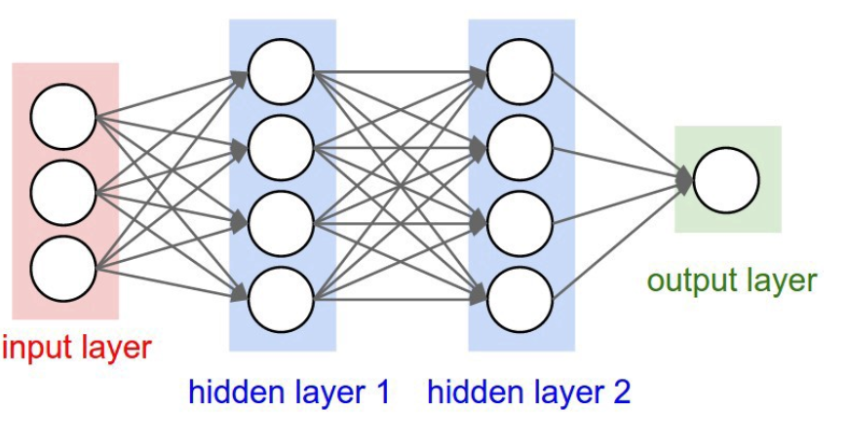
Unit 02 ㅣ Activation Functions
Activation functions
Input -> FC1 -> AF -> FC2 -> CF-> OUPUT

Slide 9
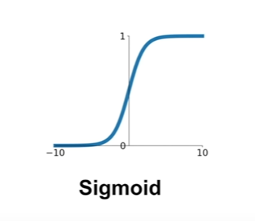
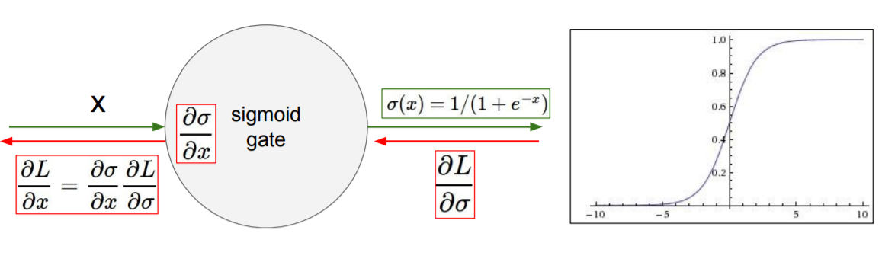
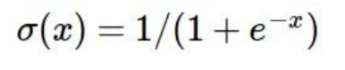
Unit 02 ㅣ Activation Functions
Activation functions
If x=-10 ?
If x=0 ?
If x=10 ?

Slide 10
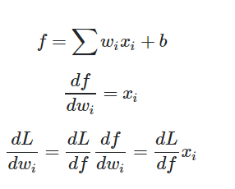
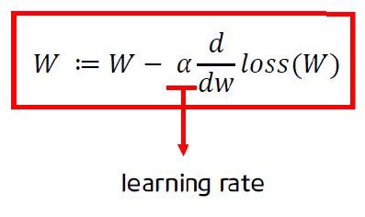
Unit 02 ㅣ Activation Functions
Activation functions -> zero-centered
If x>0

Slide 11
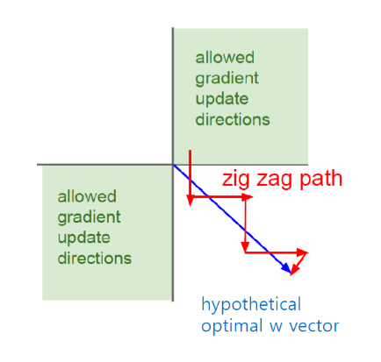
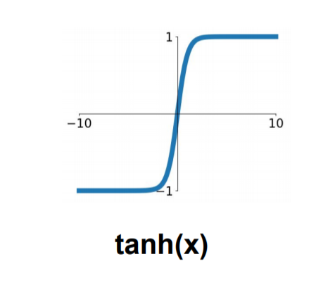
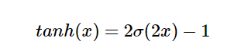
Unit 02 ㅣ Activation Functions
Activation functions -> zero-centered
W2
W1

Slide 12
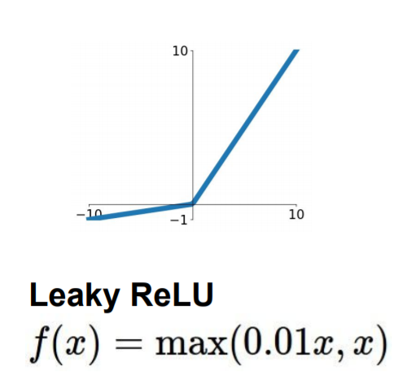
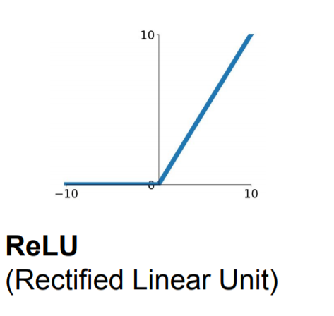
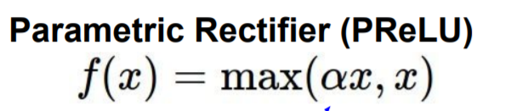
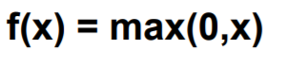
Unit 02 ㅣ Activation Functions
Activation functions
If x=-10 ?
If x=0 ?
If x=10 ?
Dead Relu

Slide 13
Unit 03 ㅣ Weight Initialization
- Activation Functions
- Weight Initialization
Optimization
Regularization

Slide 14
Unit 03 ㅣ Weight Initialization
Weight Initialization
IF W is initialized W=0?

Slide 15
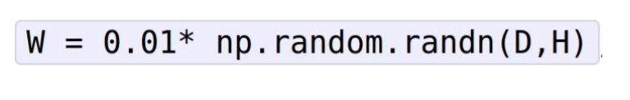
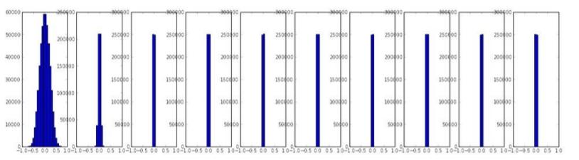
Unit 03 ㅣ Weight Initialization
Weight Initialization Small random numbers
D = Input size
H = Hidden size

Slide 16
Unit 03 ㅣ Weight Initialization
Weight Initialization Small random numbers
0.0001
W
X
X
3
0.0003

Slide 17
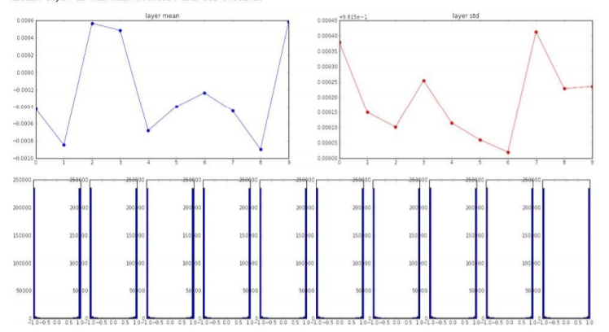
Unit 03 ㅣ Weight Initialization
Weight Initialization Big random numbers

Slide 18
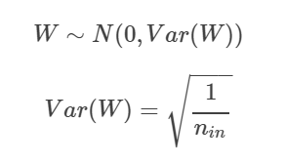
Unit 03 ㅣ Weight Initialization
Weight Initialization Xavier initialization – Glorot/ 2010
W=np.random.randn(Input_size,hidden_size)/ np.sqrt(input_size)

Slide 19
Unit 05 ㅣ Batch normalization
Batch normalization

Slide 20
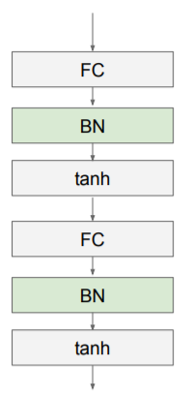
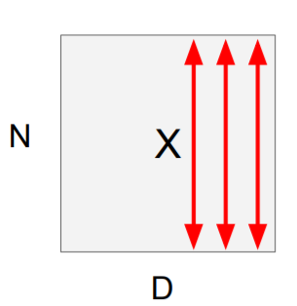
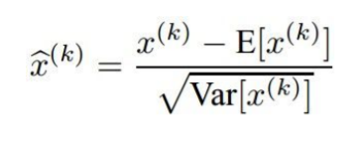
Unit 05 ㅣ Batch normalization
Batch normalization

Slide 21
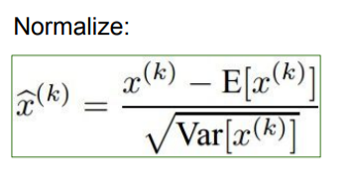
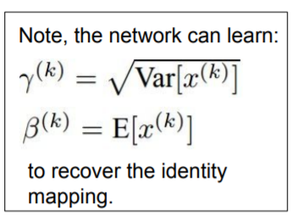
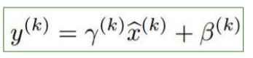
Unit 05 ㅣ Batch normalization
Batch normalization

Slide 22
Unit 04 ㅣ Optimization
- Activation Functions
Weight Initialization
- Optimization
Regularization

Slide 23
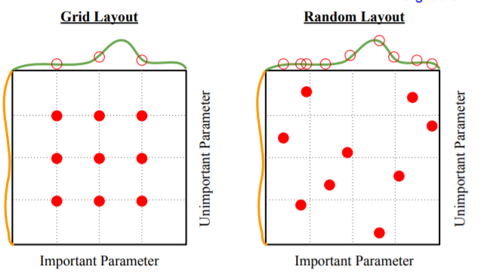
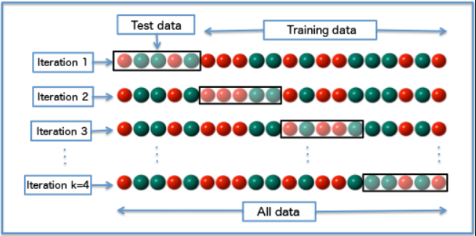
Unit 04 ㅣ Optimization
Hyperparameter Optimization

Slide 24
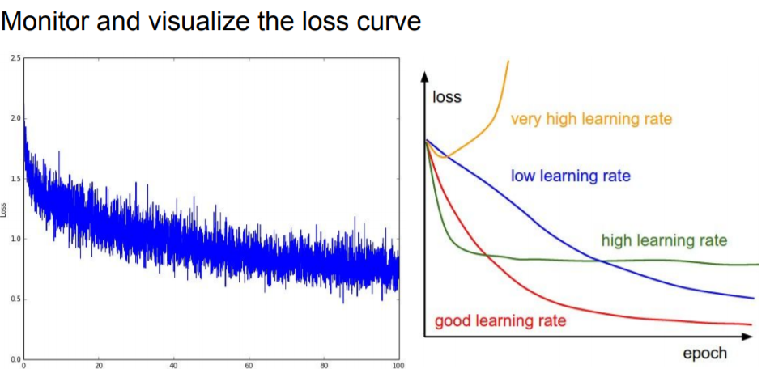
Unit 04 ㅣ Optimization
Hyperparameter Optimization

Slide 25
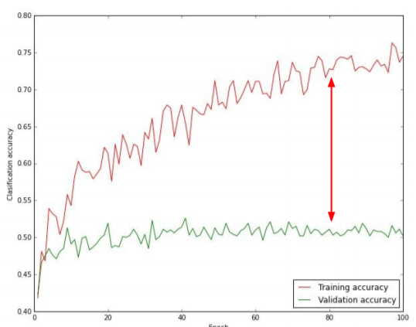
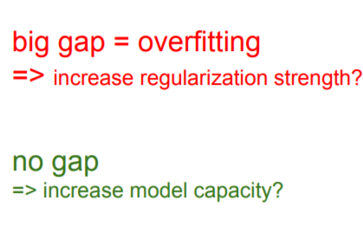
Unit 04 ㅣ Optimization
Monitor and visualize the accuracy

Slide 26
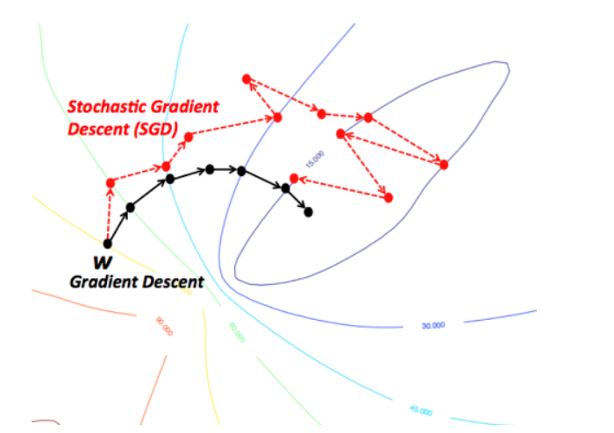
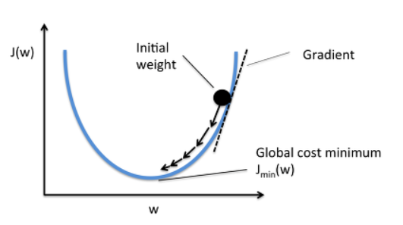
Unit 04 ㅣ Optimization
Gradient Descent
Stochastic Gradient Descent(SGD)
Gradient Descent

Slide 27
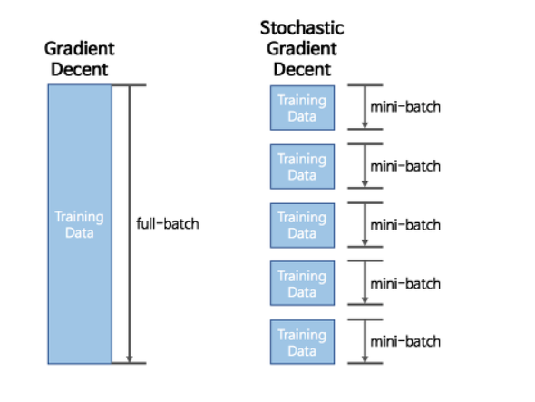
Unit 04 ㅣ Optimization
Gradient Descent / Stochastic Gradient Descent(SGD)

Slide 28
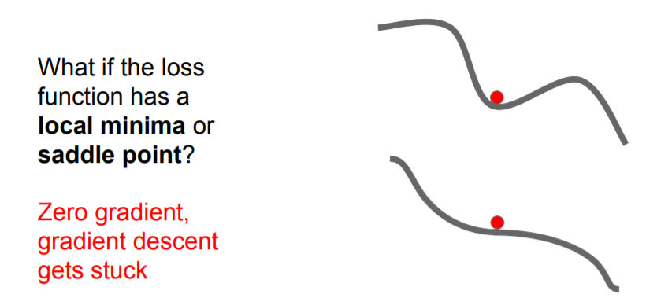
Unit 04 ㅣ Optimization
Stochastic Gradient Descent(SGD)

Slide 29
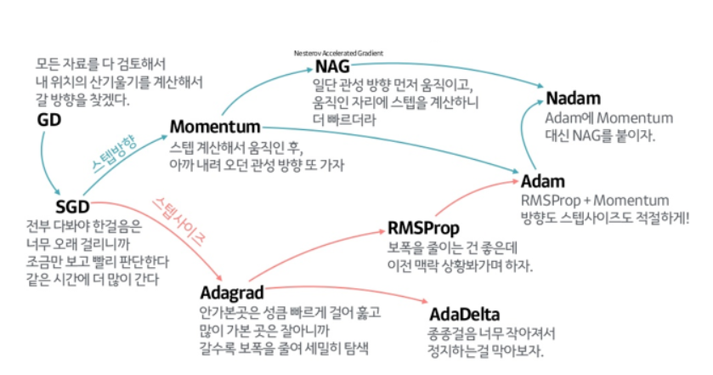
Unit 04 ㅣ Optimization
Optimizers

Slide 30

Unit 04 ㅣ Optimization
Optimizers

Slide 31
Unit 04 ㅣ Optimization
Optimizers

Slide 32
Unit 04 ㅣ Optimization
Optimizers

Slide 33
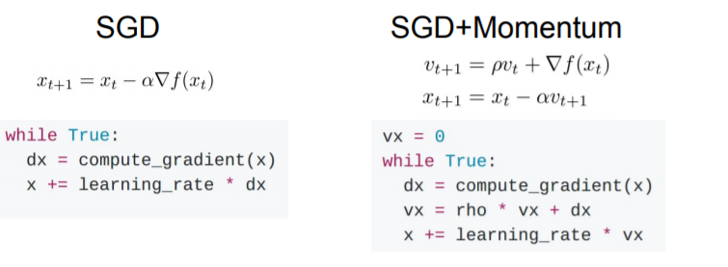
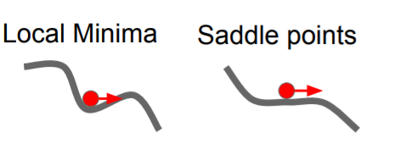
Unit 04 ㅣ Optimization
SGD + Momentum

Slide 34
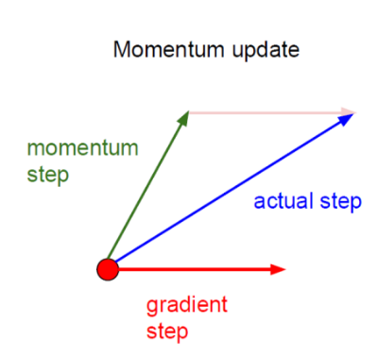
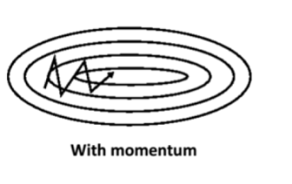
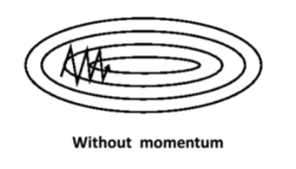
Unit 04 ㅣ Optimization
SGD + Momentum

Slide 35
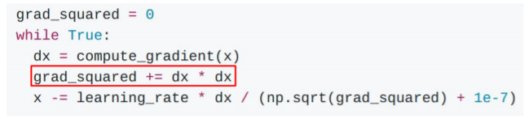
Unit 04 ㅣ Optimization
AdaGrad

Slide 36
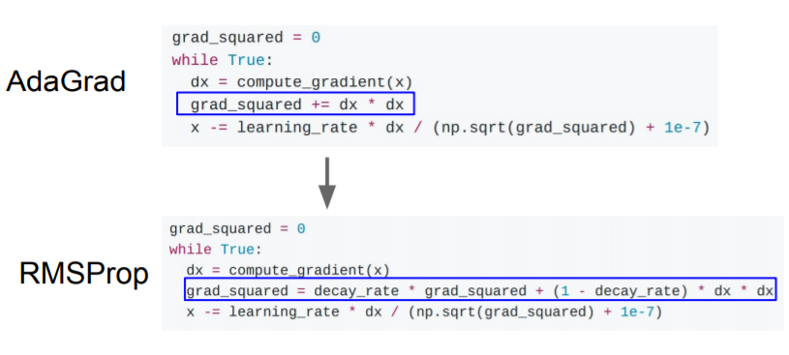
Unit 04 ㅣ Optimization
RMSProp

Slide 37
Unit 04 ㅣ Optimization
Adam

Slide 38
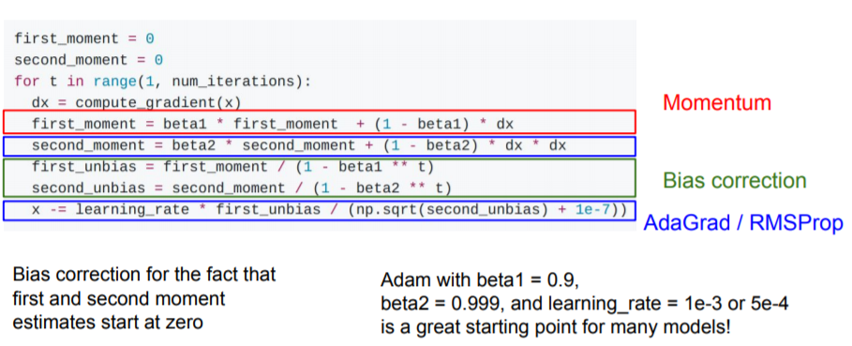
Unit 04 ㅣ Optimization
Adam

Slide 39
Unit 05 ㅣ Regularization
- Activation Functions
- Weight Initialization
- Optimization
- Regularization
Notes:
\

Slide 40
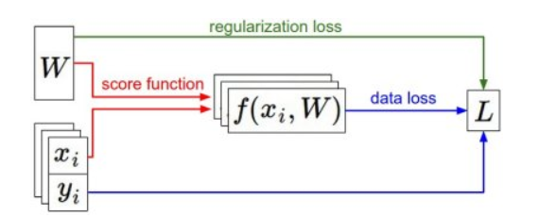
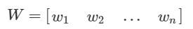
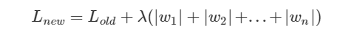
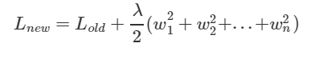
Unit 05 ㅣ Regularization
L1, L2 Regularization
L1
L2

Slide 41
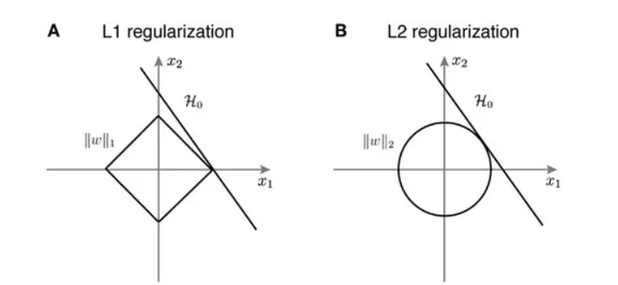
Unit 05 ㅣ Regularization
L1, L2 Regularization
L1
L2

Slide 42




Unit 05 ㅣ Regularization
Dropout

Slide 43
Unit 05 ㅣ Regularization
Dropout

Slide 44
Unit 05 ㅣ Regularization
Dropout
학습시간 증가하지만 모델이 수렴한 후에는 일반화 능력이 좋다.

Slide 45
Unit 05 ㅣ Regularization
- Activation Functions
- Weight Initialization / Batch normalization
- Optimization
- Regularization / l1 ,l2 , Drop out
Notes:
\

Slide 46


Unit 05 ㅣ In code
Notes:
\

Slide 47
Unit 05 ㅣ Reference
CS231n: Convolutional Neural Networks for Visual Recognition (Spring 2017)
Lecture 6 | Training Neural Networks I
https://www.youtube.com/watch?v=wEoyxE0GP2M&list=PLC1qU-LWwrF64f4QKQT-Vg5Wr4qEE1Zxk&index=7&t=14s
Lecture 7 | Training Neural Networks II
https://www.youtube.com/watch?v=_JB0AO7QxSA&list=PLC1qU-LWwrF64f4QKQT-Vg5Wr4qEE1Zxk&index=7
L1,L2 LOSS
https://light-tree.tistory.com/125

Slide 48
Q & A
들어주셔서 감사합니다.

